Slide 1
16S BIOINFORMATIC WORKFLOW
Epi on the Island 2024
Module 2: Analyzing, Interpreting and Presenting Microbiome-Resistome Data
June 17, 2024

Slide 2
Learning Objectives:
Understand the concepts of Operational Taxonomic Units (OTUs ) and Amplicon Sequence Variants (ASVs)
Recognize different 16S reference databases
Perform and understand a bioinformatic workflow for 16S amplicons sequencing data
Generate ASV count matrix and classification table

Slide 4
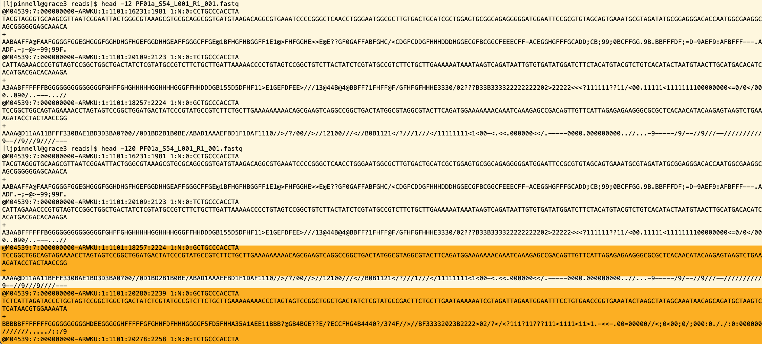

Slide 5
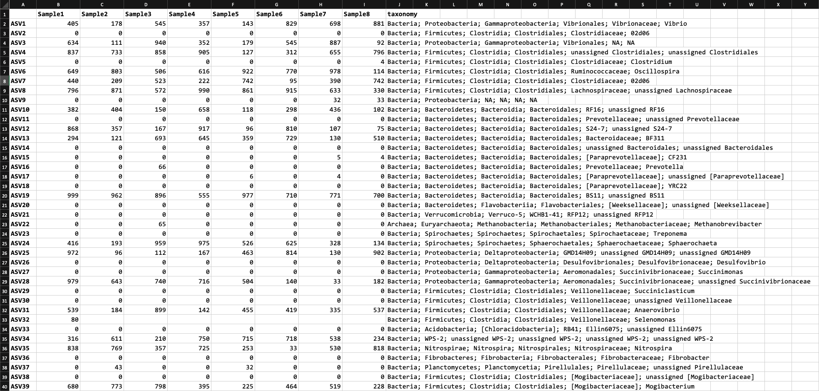

Slide 6
SEQUENCE READ
QUALITY CONTROL

Slide 7
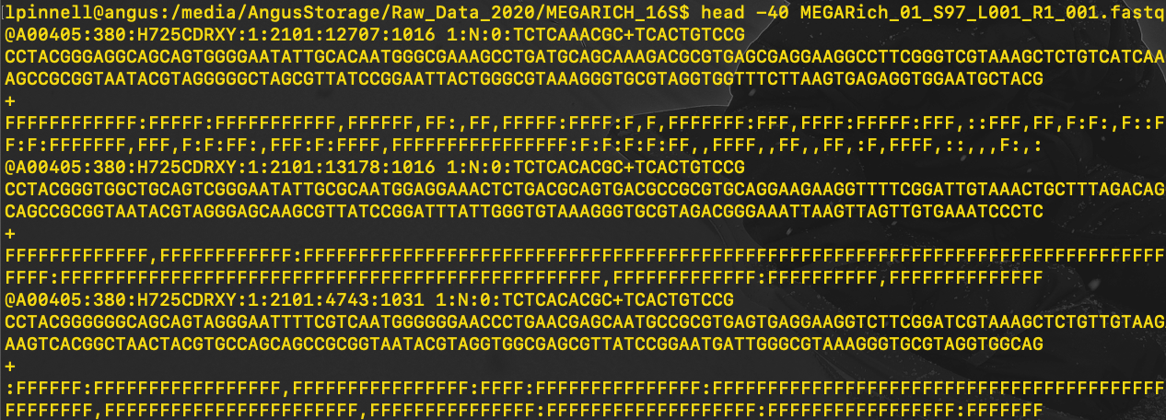
Machine ID
Lane:flowcell_grid_coordinates
Read number
index (barcode sequence)

Slide 8
DEMULTIPLEXING (MAYBE)
IF your sequences are given to you while still multiplexed you get 3 sequence files:
R1.fastq.gz (forward read)
Index.fastq.gz (index reads)
R2.fastq.gz (reverse reads)
You (a computer) can demultiplex your R1 and R2 using the index reads!

Slide 9
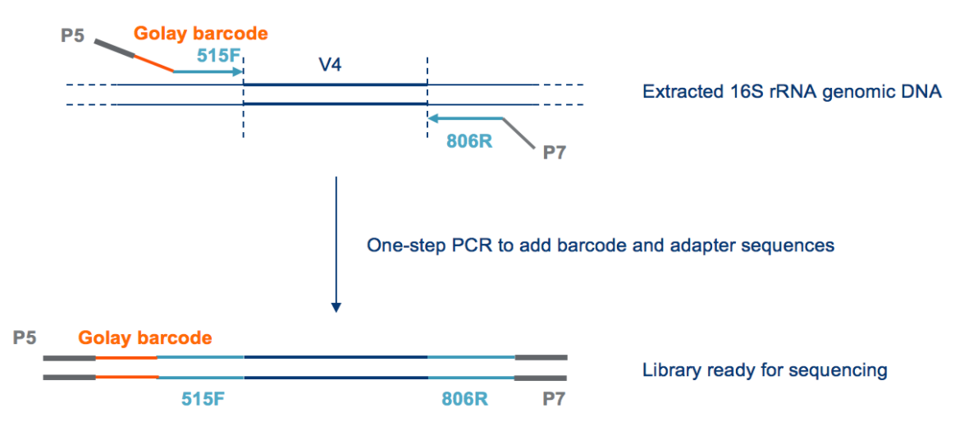
REMOVING PRIMER/ADAPTER SEQUENCES

Slide 10

REMOVING PRIMER/ADAPTER SEQUENCES
Cutadapt: finds and removes adapter, primer, and other unwated sequences from sequencing reads
Input:
your FASTQ file and the adapter/primer sequence
Reverse complement of your adapter/primer sequence
Output:
FASTQ sequence file without adapter/primer sequences
LET’S DO IT!

Slide 11
GENERATING ASVs

Slide 12

OTUs VERSUS ASVs
Operational Taxonomic Unit (OTU):
A cluster of similar nucleotide sequences that represent a single
taxonomic unit within a microbial community
Based on sequence similarity threshold (i.e., 97%)
Relies on clustering threshold, low resolution
Amplicon Sequence Variant (ASV):
A unique and exact nucleotide sequence variant
Not subjected to clustering
Higher taxonomic resolution
No arbitrary similarity threshold
Facilitates cross-study comparisons
OTUs

Slide 13
GENERATING ASVs
Denoising: generates ASVs while performing quality filter, correcting sequencing artificats (i.e., chimeras), and merging overlapping PE reads
Quality filtering*: filter low-quality sequences, ambiguous bases and expected errors within a read
Chimera: sequence artifact formed during PCR when two different template fragments combine (polymerase switches templates and incorporates one into the other)
*we’re going in depth on Tuesday!

Slide 14
GENERATING ASVs
Denoising: generates ASVs while performing quality filter, correcting sequencing artificats (i.e., chimeras), and merging overlapping PE reads
DADA2 (Divisive Amplicon Denoising Algorithm 2)*
Models error distribution from the data itself to identify and correct sequencing errors
Deblur
Uses a pre-trained error model to identify and correct sequencing errors
UNOISE (Unique Nucleotide Omission & Insertion Corrector)
Uses a statistical model to estimate error rate and identifies ASVs by considering unique k-mers

Slide 15
DADA2
Bayesian Modeling
Uses Bayesian statistical approach to model the distribution of errors in the actual sequences; builds a position-specific error model it uses to estimate errors rates for each base position
ERROR CORRECTION MODEL
Divisive Clustering
Iteratively splits clusters into finer clusters based on observed differences in base-pair abundances, allowing differentiation of true ASVs and sequencing errors with high resolution
DENOISING STRATEGY

Slide 16
PRACTICAL CONSIDERATIONS FOR DENOISING 16S DATA

Slide 17
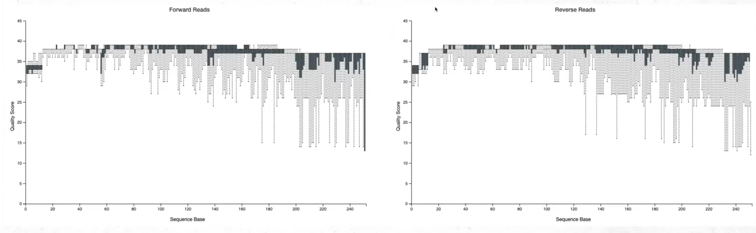
EXAMPLE 1: EXCELLENT MiSEQ DATA

Slide 18
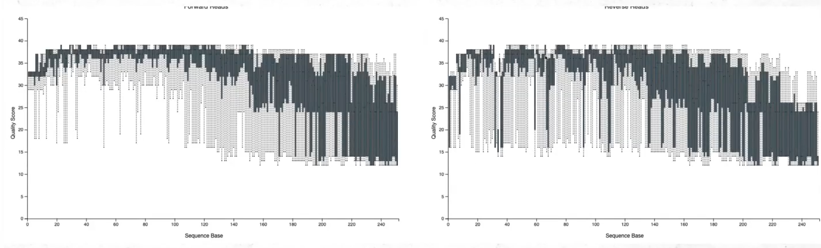
EXAMPLE 3: BAD MiSEQ DATA
LET’S DENOISE!

Slide 19
CLASSIFYING ASVs

Slide 20
16S rRNA REFERENCE DATABASES
Greengenes
PRO: well-curated, low inconsistency in taxonomic annotations
CON: poor coverage on certain taxa; newly discovered/poorly characterized
SILVA
PRO: large and very comprehensive reference database CON: some inconsistencies in taxonomic annotations in lesser studied taxa
RDP
PRO: well-curated and well established
CON: limited coverage on lesser studied taxa, not updated frequently
NCBI RefSeq (or nt)
PRO: comprehensive and cross-referenced to other
NCBI databases
CON: poor coverage, not designed for 16S
Greengenes
It’s less comprehensive

Slide 21
CLASSIFICATION METHODS
Machine-Learning Based*
DADA2, mothur, HMMER
Sequence Similarity-Based
BLAST, DIAMOND, EMBOSS
Least Common Ancestor (LCA)
Kraken2, MEGAN

Slide 22
MACHINE-LEARNING BASED METHODS
Supervised Learning: algorithm (e.g., random forests) is trained on labeled data to predict taxonomic annotations for query sequences
Unsupervised Learning: algorithm (e.g., k-means clustering) groups
sequences based on similarity and infers taxonomic annotations for each cluster
Naïve Bayes classification algorithm

Slide 23
CLASSIFYING OUR ASVs
Input Sequences: A representative sequence from each ASV in the dataset
Likelihood Calculation: Uses the pre-trained naïve bayes classifier to calculate the likelihood of observing a sequence given each taxonomic label based on the training data from SILVA
Prior Probabilities: Classifier also considers the probability of each taxonomic label occurring in the training data
Combining Probabilities: Bayes’ theorem is used to combine the likelihood of observing a feature with the probability of the taxonomic label
Represents the likelihood of an ASV belonging to each taxonomic label given its sequence

Slide 24
AN EXAMPLE OF A GENUS-LEVEL CALL
Classifier found the following probabilities of 3-mers during training:
ATG → Frequently found in Bacteroides sequences (Feature 1)
TCG → Frequently found in Mannheimia sequences (Feature 2)
CGA → Frequently found in both Bacteroides and Mannheimia sequences (Feature 3)
ASV REP SEQ
ATGCGA
ATGCGA
ATGCGA
Feature 1
(strongly associated with Bacteroides)
Feature 3
(shared between Bacteroides & Mannheimia)
Feature 2 not found

Slide 25
ASV REP SEQ
ATGCGA
ATGCGA
ATGCGA
Feature 1
(strongly associated with Bacteroides)
Feature 3
(shared between Bacteroides & Mannheimia)
Based on the presence of features 1 and 3, classifier calculates the likelihood of the sequence belonging to each sequence:
Likelihood(Bacteroides) = Prior(Bacteroides)*Likelihood(Feature1|Bacteroides)*Likelihood(Feature 3|Bacteriodes)
Likelihood(Mannheimia) = Prior(Mannheimia)*Likelihood(Feature 3|Mannheimia)
In this case, since Feature 1 is associated with Bacteroides and Feature 3 is associated with both, the classifier would predict our ASV belongs to the genus Bacteroides
Classifier’s expectation that a given sequence would belong to Mannheimia based on training data
Likelihood that feature 3 is associated with Mannheimia based on training data
LET’S CLASSIFY!

